Slide 1
The Surprisingly Swift Decline of U.S. Manufacturing Employment
Justin R. Pierce Board of Governors of the Federal Reserve System
Peter K. Schott Yale School of Management & NBER

Slide 2
Disclaimer
Any opinions and conclusions expressed herein are those of the authors and do not necessarily represent the views of the U.S. Census Bureau, the Board of Governors or its research staff. All results have been reviewed to ensure that no confidential information is disclosed.

Slide 3
Post-War U.S. Manufacturing Employment
Notes:
these figures are made in

Slide 4
Post-War U.S. Manufacturing Employment
Notes:
these figures are made in

Slide 5
Post-War U.S. Manufacturing Employment
-2.9 mill over 3 years

Slide 6
Post-War U.S. Manufacturing Employment
-2.9 mill over 3 years

Slide 7
Introduction
We link the post-2001 decline in US manufacturing employment to China’s receipt of Permanent Normal Trade Relations (PNTR)
PNTR did not change actual tariff rates
Chinese imports were eligible for low NTR rates starting in 1980
But access to these rates required annual renewal by Congress
Without renewal, tariffs would rise to higher, Smoot-Hawley levels
With PNTR, the possibility of tariff hikes was eliminated
Pre-PNTR uncertainty over possible tariff hikes likely discouraged
US firms from investing in trade relationships with Chinese firms
US firms from openings plants in China
U.S. firms from investing in labor-saving technologies
Chinese firms from making investments to export to US

Slide 8
Before Continuing…
Despite the sharp decline in employment after 2001, real value added continues rising at its historical pace
Notes:
decomp.do ~line 783

Slide 9
Outline
US-China Trade Policy
Census Data
Main results
Mechanisms
Conclusion

Slide 10
US NTR and Non-NTR Tariffs
NTR = Normal Trade Relations
Synonym for Most Favored Nation (MFN)
The US has two basic tariff schedules
NTR tariffs : for WTO members; generally low
Non-NTR tariffs : for non-market economies; generally high; set by Smoot-Hawley (1930)
How does China fit into these categories?

Slide 11
US-China Trade Policy, 1980-2001
2001 (December)
China enters WTO
Annual renewals of MFN status were uncertain
1980 (February)
China was granted temporary NTR status by the US Congress
Temporary NTR requires annual re-approval by Congress
2000 (October)
U.S. Congress grants China PNTR, eliminating the risk that a failed vote might lead to a jump in tariffs

Slide 12
Plausible Mechanism?
“U.S. companies expect to benefit from billions of dollars in new business and an end to years of uncertainty in which they had put off major decisions about investing in China.
NYT 2000.9.20
“[P]rivate sector officials cited uncertainty surrounding the annual renewal of China’s most-favored-nation trade status as the single most important issue affecting U.S. trade relations with China….[T]he great majority of the U.S. business associations and companies… contacted told us that the annual uncertainty surrounding China’s MFN status potentially hinders their business activities in China.”
US GAO 1994.5.4
“While the risk that the United States would withdraw NTR status from China may be small, if it did occur the consequences would be catastrophic for U.S. toy companies given the 70 percent non-MFN U.S. rate of duty applicable to toys.”
Testimony of Thomas F. St. Maxens (Mattel)
Ways and Means Committee 2000.2.16
“In the months since the enactment of [PNTR] there has been an escalation of production shifts out of the U.S. and into China. According to our media-tracking data, between October 1, 2000 and April 30, 2001 more than eighty corporations announced their intentions to shift production to China, with the number of announced production shifts increasing each month from two per month in October to November to nineteen per month by April.”
Bronfenbrenner et al. (2001.6.30)
U.S.-China Security Review Commission

Slide 13
The “NTR Gap” i=industry
Define the difference between the non-NTR and NTR rates as
NTR Gap_{i} = Non-NTR Tariff_{i} – NTR Tariff_{i}
Calculated using tariff-line (HS8) data from Feenstra et al. (2003)
Use tariffs for 1999, the year before PNTR
Gap for industry i is the mean across tariff lines in industry i

Slide 14
Distribution of NTR Gap
89 percent of the variation in the NTR gap across industries arises from variation in non-NTR rates, which were set in 1930
The higher the NTR gap, the greater the industry’s exposure to potential tariff increases before PNTR
Mean: 0.32
Std: 0.15

Slide 15
Preview of Results
Divide U.S. manufacturing industries or import products into two groups based on whether their NTR gap is above or below the median
Plot their trajectory before and after PNTR

Slide 16
Preview of Findings – Employment Public NBER-CES Data
Before PNTR: high- and low-gap industries follow roughly parallel trends
Post PNTR: employment falls more sharply among high-gap industries
Note: we use the NTR gap as a continuous variable in our regression analysis.

Slide 17
Preview of Findings – Trade Public Census Trade Data
Imports from China in the more-exposed products jump after PNTR

Slide 18
Preview of Findings – Trade Public Census Trade Data
Imports from China in the more-exposed products jump after PNTR
This trend is not present in imports from rest-of-world (ROW)
China
ROW

Slide 19
Preview of Findings – Trade Public Census Trade Data
Imports from China in the more-exposed products jump after PNTR
This trend is not present in imports from rest-of-world (ROW)
Below, we use census data to examine margins of adjustment
New US importers
New Chinese Exporters
New Importer-exporter pairs
China
ROW

Slide 20
Related Research
Employment and trade liberalization
Lots of papers
China: Autor et al. (2013); Bloom et al. (2015)
Investment under uncertainty
Lots of papers
Trade: Handley (2014); Handley and Limao (2014a, 2014b)
“Jobless” recoveries
Manufacturing: Faberman (2012)
Supply-chain linkages
US manufacturing: Ellison, Glaeser and Kerr (2010)
Trade: Baldwin and Venables (2013)

Slide 21
Outline
US-China Trade Policy
Census Data
Main results
Mechanisms
Conclusion

Slide 22
Census Data
LBD
CM
LFTTD
Longitudinal Business Databse
Employment of all U.S. establishments
Annual data but limited information
Concordance issue
Census of Manufactures
Employment + other attributes for all manufacturing establishments, 1992(5)2007
Lots of information but low frequency
Transaction-level US import data
Value
U.S. importer and foreign exporter ID’s

Slide 23
Outline
US-China Trade Policy
Data
Main results
Mechanisms
Conclusion

Slide 24
Empirical Strategy i=industry; t=year
DID specification
Regress industry-year employment from 1990-2007 on interaction of NTR Gap and indicator for post-PNTR period (year>2000)
Add covariates that account for
Industry characteristics
Other policy changes (MFA, China’s entry into WTO, etc.)

Slide 25
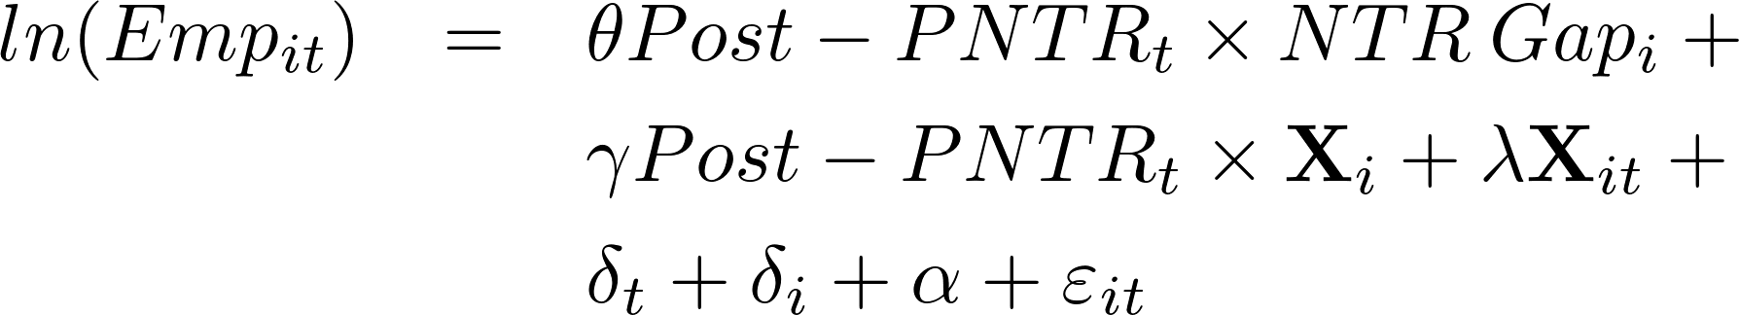
Empirical Strategy i=industry; t=year
DID specification
Regress industry-year employment from 1990-2007 on interaction of NTR Gap and indicator for post-PNTR period (year>2000)
Add covariates that account for
Industry characteristics
Other policy changes (MFA, China’s entry into WTO, etc.)
Time-Varying
E.g., MFA, NTR rate, etc.
Time-Invariant
Initial K/L, Changes in Chinese import tariffs, etc.
Industry and year FE.

Slide 26
Baseline Results (LBD)

Slide 27
Baseline Results (LBD)
Industries with higher NTR gaps experience larger employment declines following PNTR

Slide 28
Baseline Results (LBD)
Industries with higher NTR gaps experience larger employment declines following PNTR
Economic significance: for each industry, compute the implied effect of PNTR (vs the pre-period) relative to a hypothetical industry with a zero NTR gap

Slide 29
Baseline Results (LBD)
Not much action in terms of the other covariates, except for skill intensity, changes in Chinese import tariffs and the MFA phase-out

Slide 30
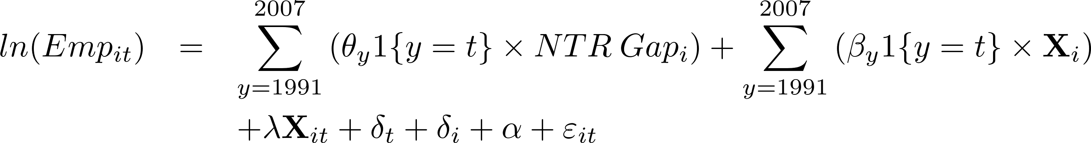
Timing (LBD)
The NTR gap should be correlated with employment after PNTR but not before

Slide 31
Timing (LBD)
Plot the 95% confidence interval of the annual DID coefficients for two specifications: no additional controls versus baseline controls

Slide 32
Linearity (LBD)
There is some support for the idea that employment loss accelerates with the NTR gap
The implied impacts from these specifications, however, are similar to those in the baseline specification

Slide 33
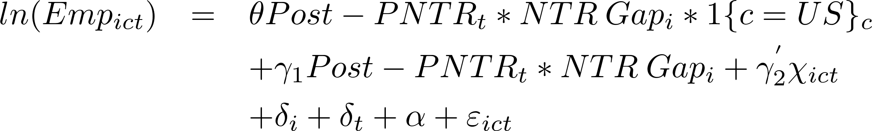
US vs EU (UNIDO) i=industry, t=year, c=country
In contrast to the United States, the EU granted permanent most-favored-nation status to China in 1980
We compare employment in the two regions via a triple DID

Slide 34
US vs EU (UNIDO) i=industry, t=year, c=country
In contrast to the United States, the EU granted permanent most-favored-nation status to China in 1980
We compare employment in the two regions via a triple DID

Slide 35
US vs EU (UNIDO) i=industry, t=year, c=country
In contrast to the United States, the EU granted permanent most-favored-nation status to China in 1980
We compare employment in the two regions via a triple DID
Notes: Each column displays the results of an industry-level OLS generalized difference-in-differences regression of the log employment on industry (i) and year (t) fixed effects and covariates discussed in text. Data span 1998 and 2005. Interactions required to identify the triple difference-in-differences term are suppressed. Robust standard errors adjusted for clustering at the industry level are displayed below each coefficient. Observations are weighted by initial employment. Superscripts ***, ** and * represent statistical significance at the 1, 5 and 10 percent levels.

Slide 36
Outline
US-China Trade Policy
Data
Main result
Mechanisms
Conclusion

Slide 37
Mechanisms
U.S. Imports
Chinese Exports
U.S. factor intensity
Input-Output Linkages

Slide 38

U.S. Imports (LFTTD) h=product, c=country, t=year
Compare products with varying NTR gaps (first difference) before and after PNTR (second difference) and across source countries (third difference) for the years 1992 to 2007
where O_{hct} represents one of
Import value
Number of U.S. importers
Number of Chinese exporters
Number of importer-exporter pairs
Time-Varying
Exchange rate and NTR rate
Fixed Effects
Interactions needed to identify θ

Slide 39
U.S. Imports (LFTTD) h=product, c=country, t=year
Compare products with varying NTR gaps (first difference) before and after PNTR (second difference) and across source countries (third difference) for the years 1992 to 2007

Slide 40
Chinese Exports (NBS) h=product, c=country, t=year
Similar to U.S. imports but using Chinese transaction-level trade data from the China National Bureau of Statistics (NBS)
Firm x six-digit HS x year
Can observe export “type”
General
Processing & Assembly
Can observe firm ownership type
SOE
Private domestic
Private foreign

Slide 41
Chinese Exports (NBS) h=product, c=country, t=year
Notes: Table reports results of product-country-year level generalized triple difference-in-differences OLS regressions of log Chinese export value on noted triple difference-in-differece term as well as product (h), country (c) and year (t) fixed effects. Results for fixed effects as well as all other terms required to identify the triple difference-in-differences term of interest are suppressed. Data span 2000 to 2005. Robust standard errors adjusted for clustering at the product level are displayed below each coefficient. All exports are defined as the sum of general and processing & assembly (P&A) exports. All firms are the union of state-owned enterprises, privately owned domestic firms and privately owned foreign firms. Superscripts ***, ** and * represent statistical significance at the 1, 5 and 10 percent levels.

Slide 42
Chinese Exports (NBS) h=product, c=country, t=year
All three types of exports experience relative growth following PNTR
Notes: Table reports results of product-country-year level generalized triple difference-in-differences OLS regressions of log Chinese export value on noted triple difference-in-differece term as well as product (h), country (c) and year (t) fixed effects. Results for fixed effects as well as all other terms required to identify the triple difference-in-differences term of interest are suppressed. Data span 2000 to 2005. Robust standard errors adjusted for clustering at the product level are displayed below each coefficient. All exports are defined as the sum of general and processing & assembly (P&A) exports. All firms are the union of state-owned enterprises, privately owned domestic firms and privately owned foreign firms. Superscripts ***, ** and * represent statistical significance at the 1, 5 and 10 percent levels.

Slide 43
Chinese Exports (NBS) h=product, c=country, t=year
All three types of exports experience relative growth following PNTR
Relative growth occurs among all three firm types, including “foreign” which may indicate within-firm offshoring by US firms
Notes: Table reports results of product-country-year level generalized triple difference-in-differences OLS regressions of log Chinese export value on noted triple difference-in-differece term as well as product (h), country (c) and year (t) fixed effects. Results for fixed effects as well as all other terms required to identify the triple difference-in-differences term of interest are suppressed. Data span 2000 to 2005. Robust standard errors adjusted for clustering at the product level are displayed below each coefficient. All exports are defined as the sum of general and processing & assembly (P&A) exports. All firms are the union of state-owned enterprises, privately owned domestic firms and privately owned foreign firms. Superscripts ***, ** and * represent statistical significance at the 1, 5 and 10 percent levels.

Slide 44
Changes in U.S. Factor Intensity
Use CM to examine changes in firm employment by production versus non-production worker, and also changes in capital stock
CM available only every 5 years, so regression sample now includes only 1992, 1997, 2001, 2007
Same DID specification as before

Slide 45
Changes in U.S. Factor Intensity
Industry level
PNTR is associated with increased capital and skill intensity
Decline in production workers steeper than non-production
Little change in capital
Plant level
PNTR is associated with increased capital intensity
Rise in plant and industry capital intensity is consistent with
Changes in product composition (Khandelwal 2010)
Adoption of labor-saving technologies (Bloom et al 2015)
So, PNTR may be associated with employment reductions beyond those attributable to replacement of U.S. production by Chinese imports

Slide 46
Changes in U.S. Factor Intensity (CM) Industry Level

Slide 47
Changes in U.S. Factor Intensity (CM) Plant Level

Slide 48
Additional Plant-Level Results (LBD)
Compare plant employment and plant death regressions
Reaction to PNTR included both shrinking and dying
Input-output linkages
Use input-output tables to compute plants’ exposure to PNTR the inputs they purchase (upstream NTR gap) and the industries they sell to (downstream NTR gap)
Employment among continuing plants and plant survival respond negatively to exposure to PNTR in downstream
Indirect evidence of trade-induced supply-chain disruptions (Baldwin and Venables 2013)

Slide 49
Additional Plant-Level Results (LBD)

Slide 50
Conclusions
Strong link between US manufacturing job loss and PNTR
Not evident in EU which did not undergo similar policy change
Potential mechanisms include
Greater incentives for U.S. firms to import inputs and final goods
Greater incentives for Chinese firms to scale up exports
Greater incentives for U.S. firms to introduce labor-saving technologies
Next steps
Did PNTR induce reallocation within firms?
How did PNTR affect procurement patterns?

Slide 51
Thanks!

